Slide 1
Lecture 11:
Training Neural Networks
Part V

Slide 2
Parameter Updates

Slide 3
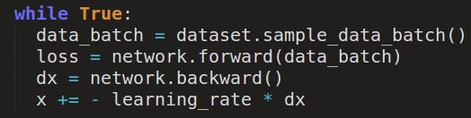
Training a neural network, main loop:

Slide 4
Training a neural network, main loop:
simple gradient descent update
now: complicate.

Slide 5
Image credits: Alec Radford

Slide 6
Suppose loss function is steep vertically but shallow horizontally:
Q: What is the trajectory along which we converge towards the minimum with SGD?

Slide 7
Suppose loss function is steep vertically but shallow horizontally:
Q: What is the trajectory along which we converge towards the minimum with SGD?

Slide 8
Suppose loss function is steep vertically but shallow horizontally:
Q: What is the trajectory along which we converge towards the minimum with SGD? very slow progress along flat direction, jitter along steep one

Slide 9


Momentum update
- Physical interpretation as ball rolling down the loss function + friction (mu coefficient).
- mu = usually ~0.5, 0.9, or 0.99 (Sometimes annealed over time, e.g. from 0.5 -> 0.99)

Slide 10
Momentum update
Allows a velocity to “build up” along shallow directions
Velocity becomes damped in steep direction due to quickly changing sign

Slide 11
SGD
vs
Momentum
notice momentum
overshooting the target, but overall getting to the minimum much faster.

Slide 12
Nesterov Momentum update
Ordinary momentum update:
momentum
step
actual step
gradient
step

Slide 13
Nesterov Momentum update
Momentum update
Nesterov momentum update
“lookahead” gradient step (bit different than original)
momentum
step
momentum
step
actual step
actual step
gradient
step

Slide 14
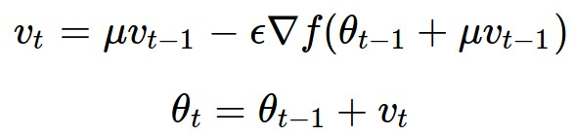
Nesterov Momentum update
Momentum update
Nesterov momentum update
“lookahead” gradient step (bit different than original)
momentum
step
momentum
step
actual step
actual step
gradient
step
Nesterov: the only difference...

Slide 15

Nesterov Momentum update
Slightly inconvenient…
usually we have :

Slide 16

Nesterov Momentum update
Slightly inconvenient…
usually we have :
Variable transform and rearranging saves the day:

Slide 17
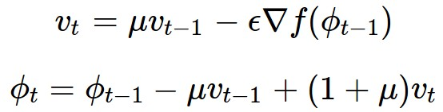
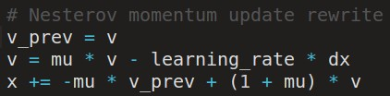
Nesterov Momentum update
Slightly inconvenient…
usually we have :
Variable transform and rearranging saves the day:
Replace all thetas with phis, rearrange and obtain:

Slide 18
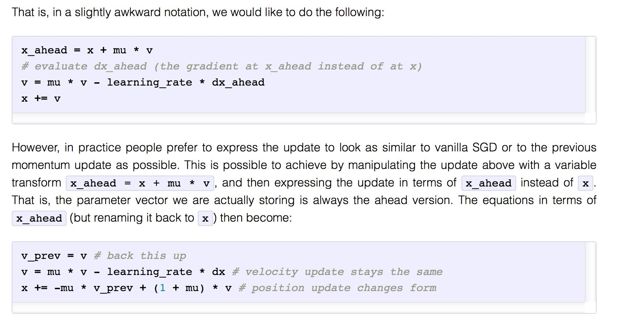
Nesterov Momentum update: another view

Slide 19
nag =
Nesterov Accelerated Gradient

Slide 20

AdaGrad update
[Duchi et al., 2011]
Added element-wise scaling of the gradient based on the historical sum of squares in each dimension

Slide 21
AdaGrad update
Q: What happens with AdaGrad?

Slide 22
AdaGrad update
Q2: What happens to the step size over long time?

Slide 23

RMSProp update
[Tieleman and Hinton, 2012]

Slide 24
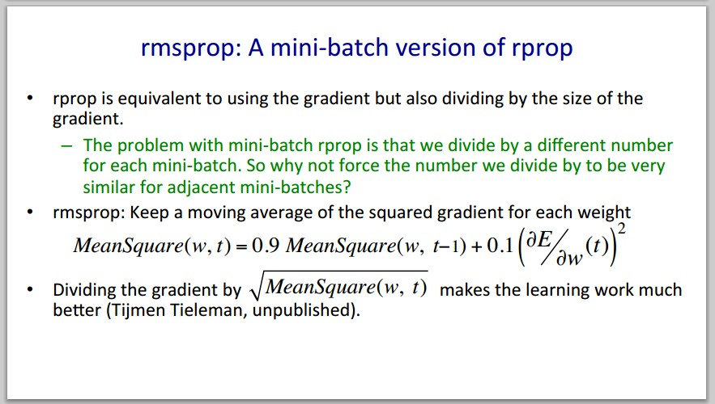
Introduced in a slide in Geoff Hinton’s Coursera class, lecture 6

Slide 25

Introduced in a slide in Geoff Hinton’s Coursera class, lecture 6
Cited by several papers as:

Slide 26
adagrad
rmsprop

Slide 27
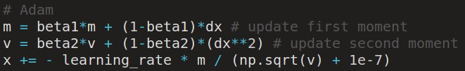
Adam update
[Kingma and Ba, 2014]
(incomplete, but close)

Slide 28
Adam update
[Kingma and Ba, 2014]
(incomplete, but close)
momentum
RMSProp-like
Looks a bit like RMSProp with momentum

Slide 29
Adam update
[Kingma and Ba, 2014]
(incomplete, but close)
momentum
RMSProp-like
Looks a bit like RMSProp with momentum

Slide 30
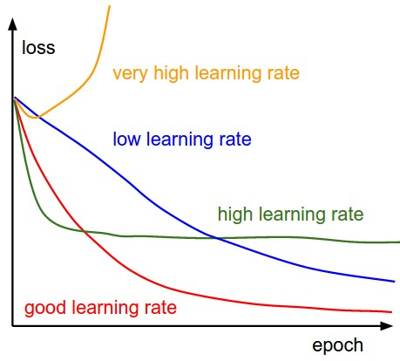
SGD, SGD+Momentum, Adagrad, RMSProp, Adam all have learning rate as a hyperparameter.
Q: Which one of these learning rates is best to use?

Slide 31


SGD, SGD+Momentum, Adagrad, RMSProp, Adam all have learning rate as a hyperparameter.
=> Learning rate decay over time!
step decay:
e.g. decay learning rate by half every few epochs.
exponential decay:
1/t decay:

Slide 32

Second order optimization methods
second-order Taylor expansion:
Solving for the critical point we obtain the Newton parameter update:
Q: what is nice about this update?

Slide 33
Second order optimization methods
second-order Taylor expansion:
Solving for the critical point we obtain the Newton parameter update:
notice:
no hyperparameters! (e.g. learning rate)
Q2: why is this impractical for training Deep Neural Nets?

Slide 34
Second order optimization methods
Quasi-Newton methods (BGFS most popular):
instead of inverting the Hessian (O(n^3)), approximate inverse Hessian with rank 1 updates over time (O(n^2) each).
L-BFGS (Limited memory BFGS):
Does not form/store the full inverse Hessian.

Slide 35
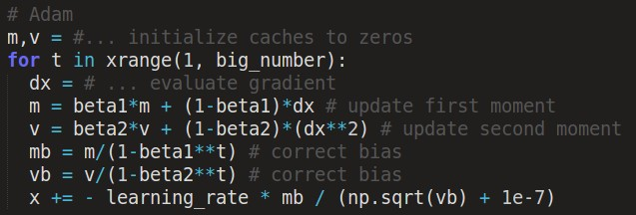
Adam update
[Kingma and Ba, 2014]
momentum
bias correction
(only relevant in first few iterations when t is small)
RMSProp-like
The bias correction compensates for the fact that m,v are initialized at zero and need some time to “warm up”.

Slide 36
L-BFGS
Usually works very well in full batch, deterministic mode
i.e. if you have a single, deterministic f(x) then L-BFGS will probably work very nicely
Does not transfer very well to mini-batch setting. Gives bad results. Adapting L-BFGS to large-scale, stochastic setting is an active area of research.

Slide 37
In practice:
Adam is a good default choice in most cases
If you can afford to do full batch updates then try out L-BFGS (and don’t forget to disable all sources of noise)

